Slide 1


Slide 2
How Dr. Evil & Drones Will Help us Monitor Vermont’s Landscape

Slide 3


Slide 4
When I ask for sharks with frickin' laser beams on their heads, I expect sharks with frickin' laser beams on their heads!

Slide 5
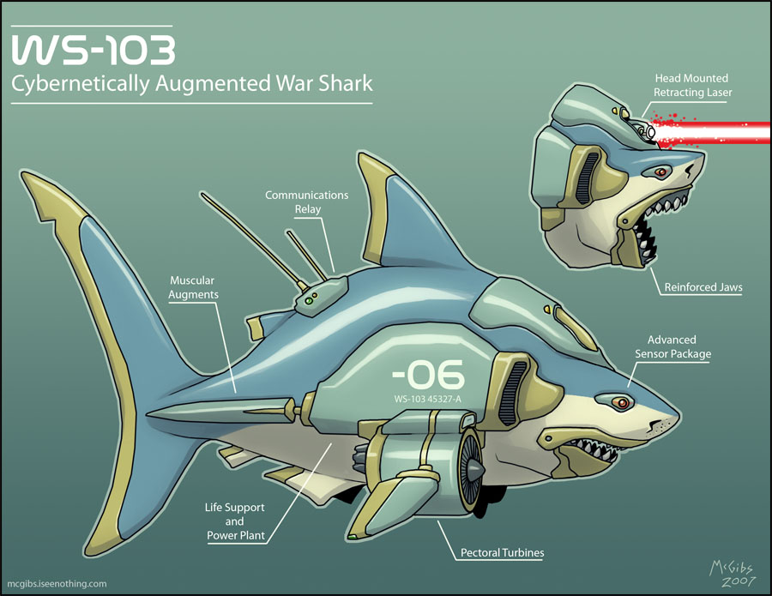

Slide 6
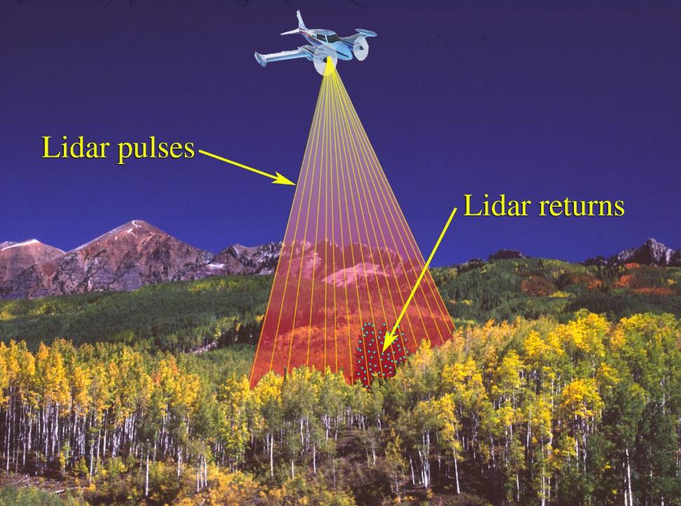

Slide 7
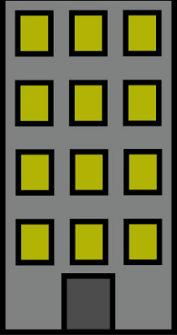
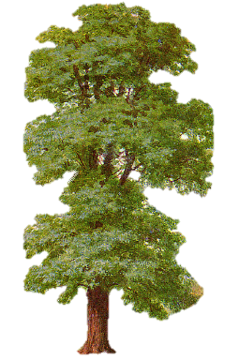

Slide 8
X = 477589.675
Y = 786620.334
Z = 532
X = 47780.122
Y = 786621.913
Z = 384

Slide 9
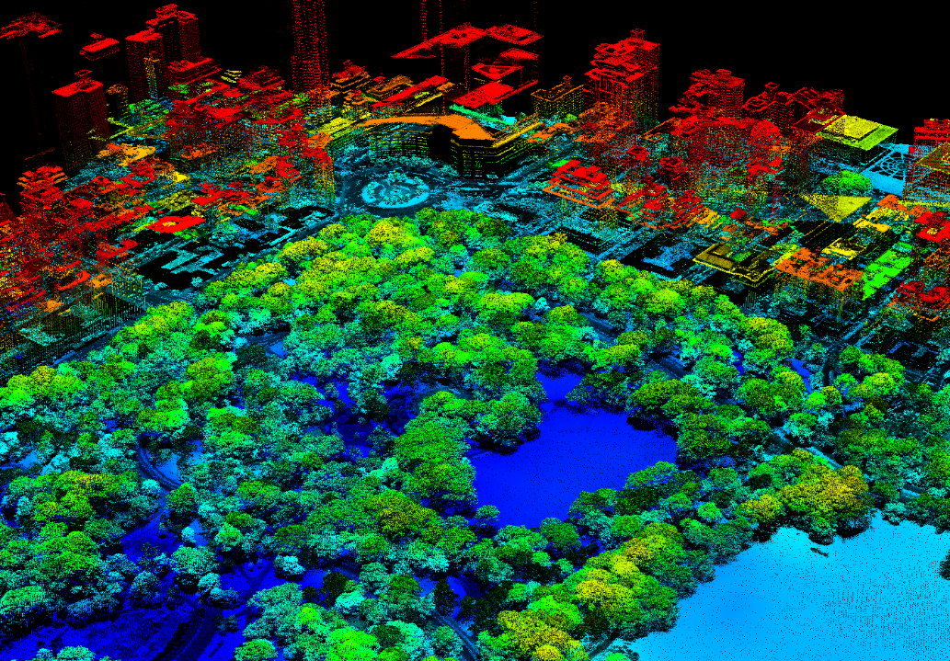

Slide 10
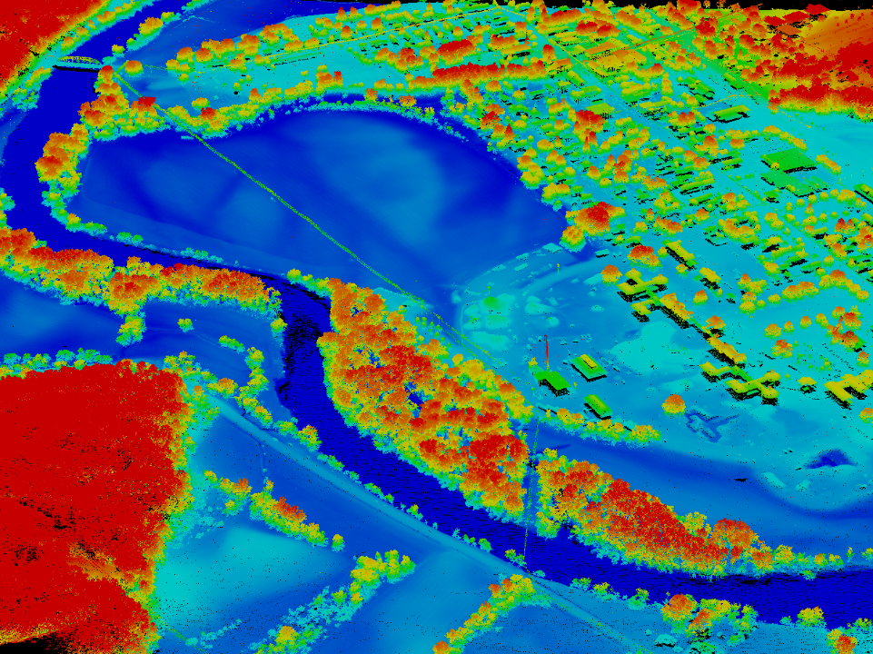

Slide 11
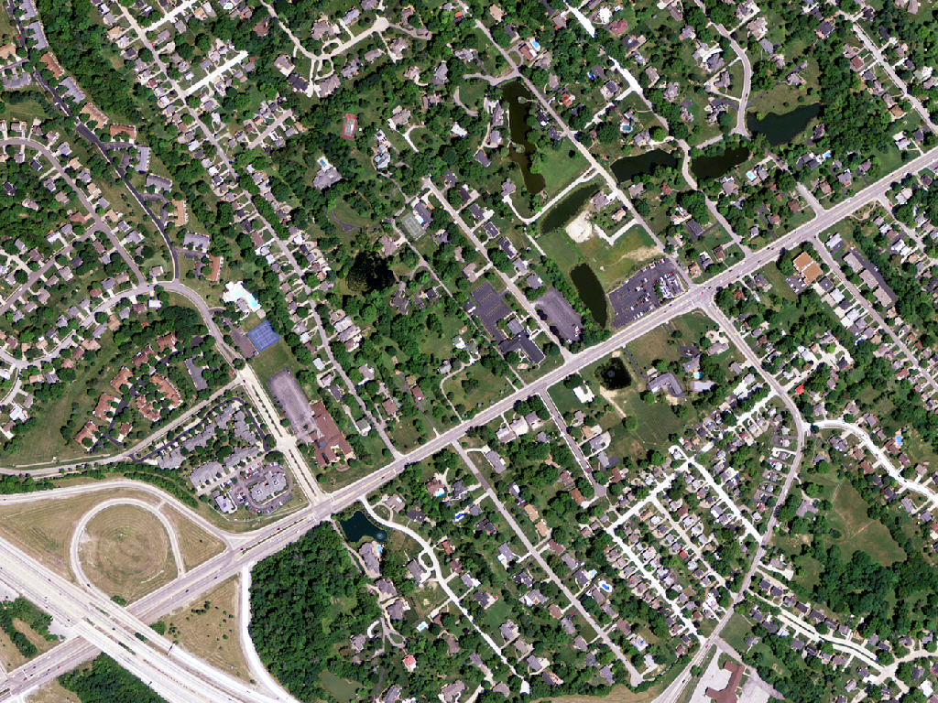
Notes:
2012 Aerial Imagery (1m)

Slide 12
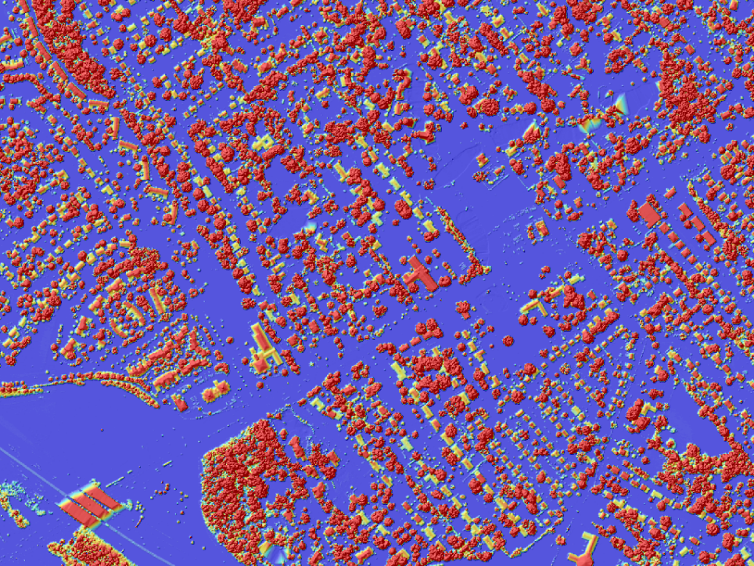
Notes:
Normalized Digital Surface Model (NDSM) colored by elevation.

Slide 13
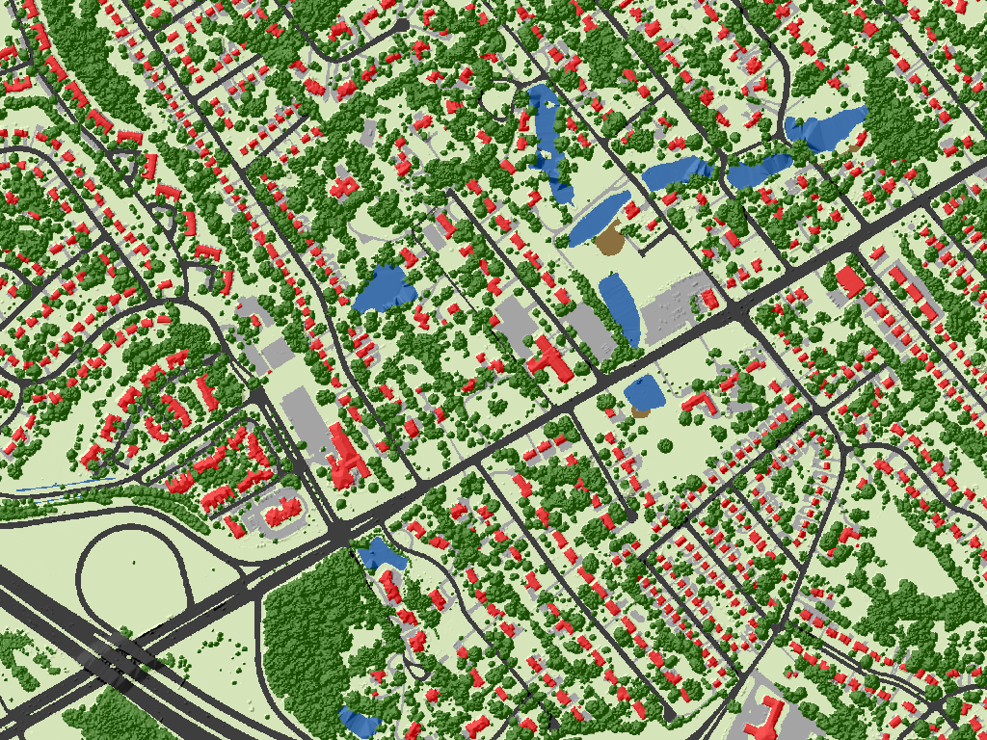
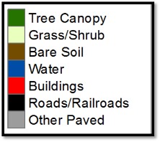
Notes:
Seven class land cover derived from high-resolution aerial imagery and LiDAR overlaid on a Normalized Digital Surface Model (NDSM).

Slide 14
Canopy Height

Slide 15
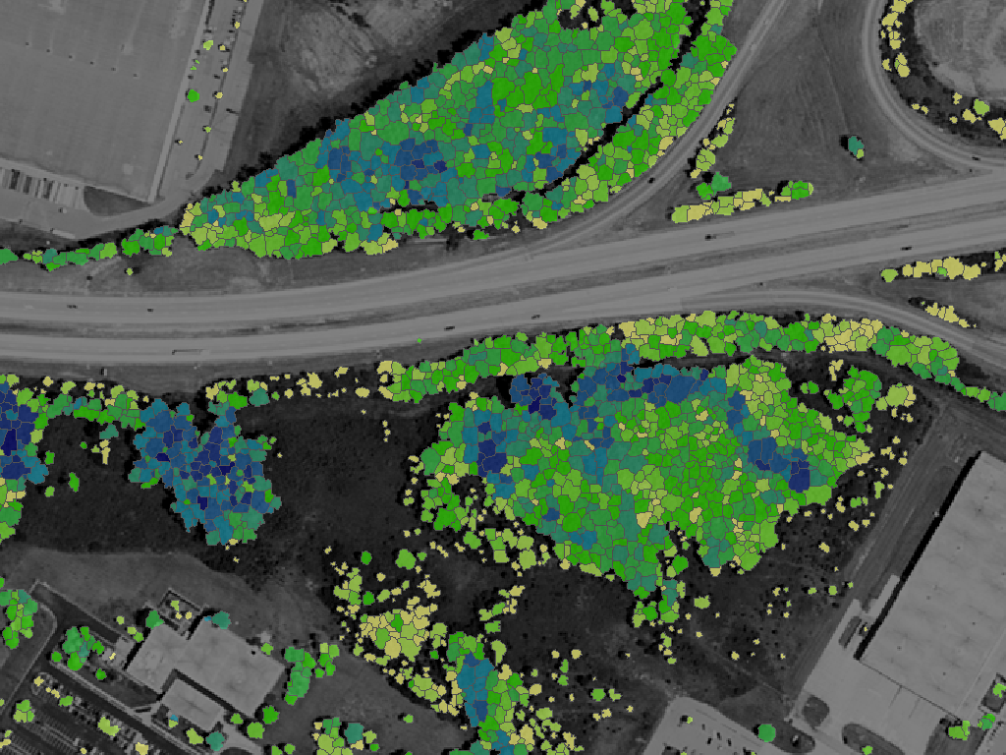
Notes:
Average tree canopy height in feet.

Slide 16
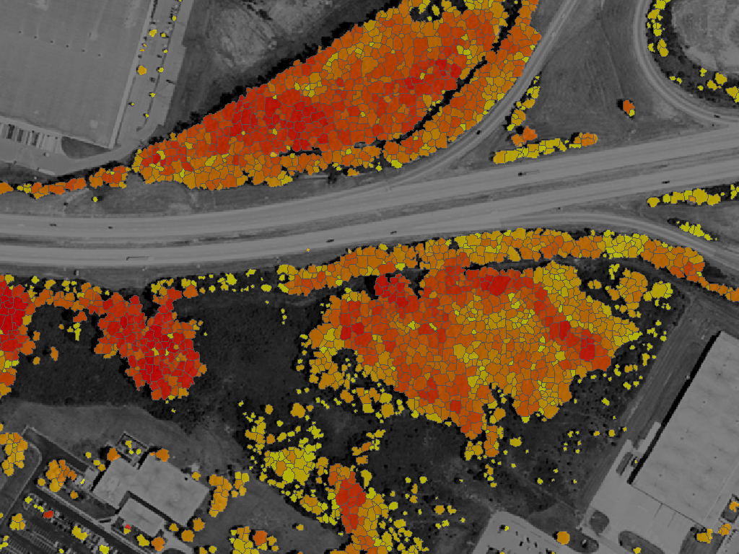
Notes:
Maximum tree canopy height in feet.

Slide 17
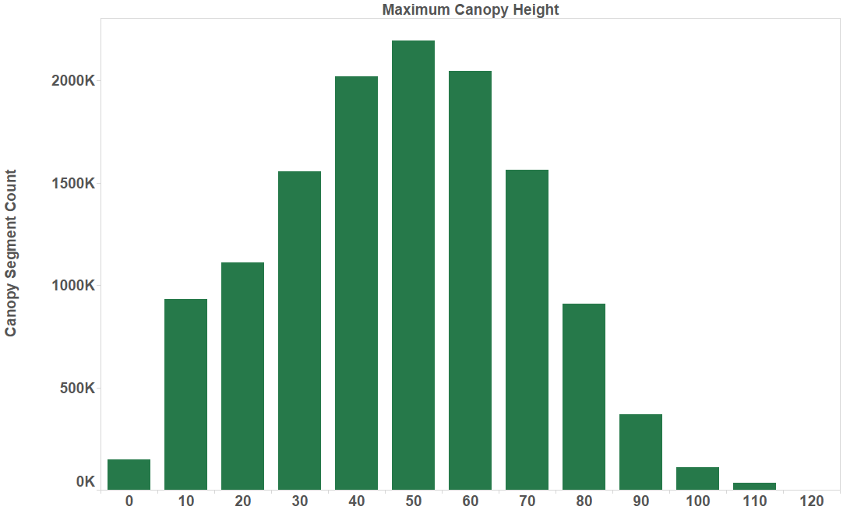
Notes:
The height of the bar reflects the number of tree canopy segments and each bar represents the height of tree canopy.

Slide 18
Forest Patch

Slide 19
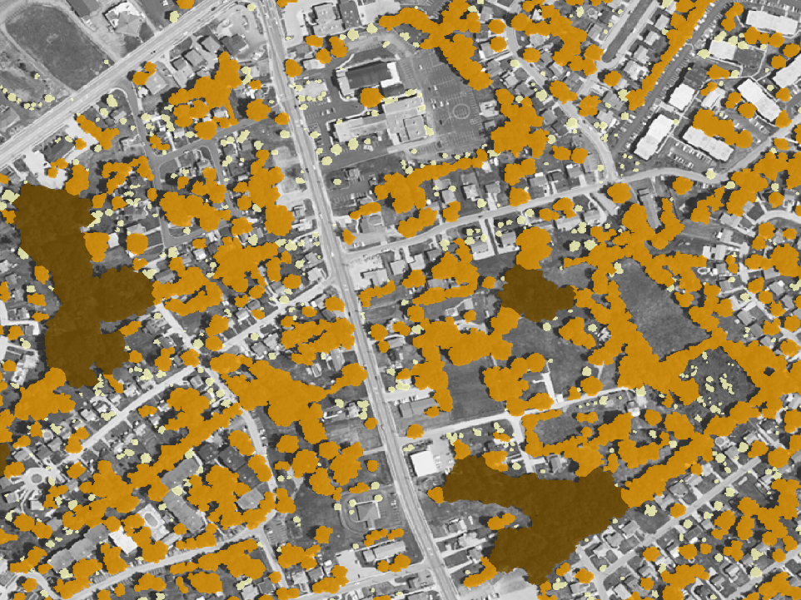
Notes:
Forest Patch size classified from large to small.

Slide 20
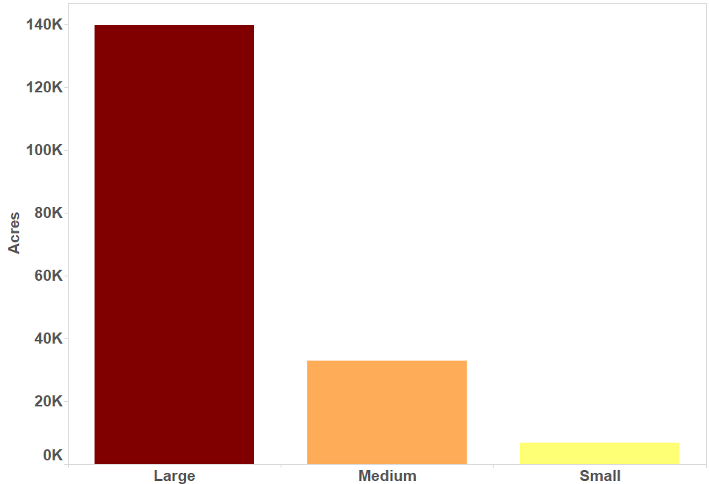
Notes:
Number of acres each forest patch size contains.

Slide 21


Slide 22
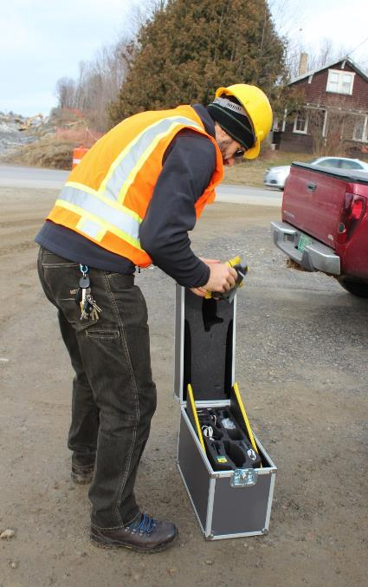
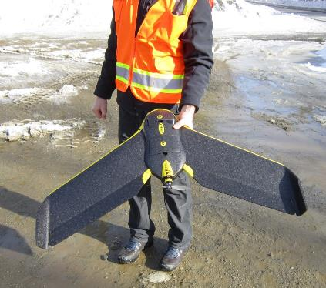


Slide 23
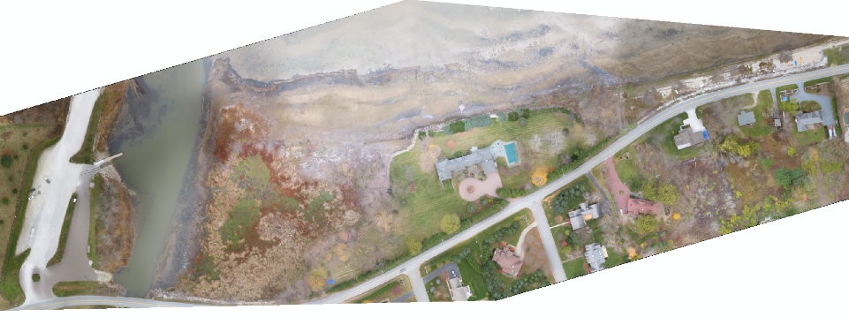
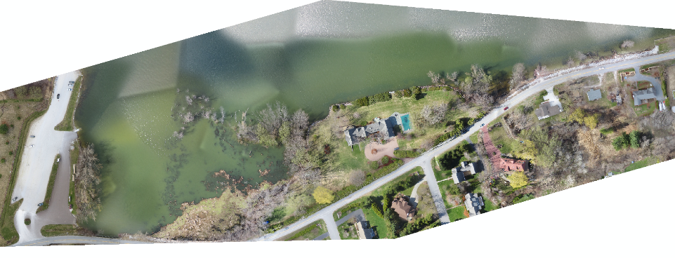

Slide 24
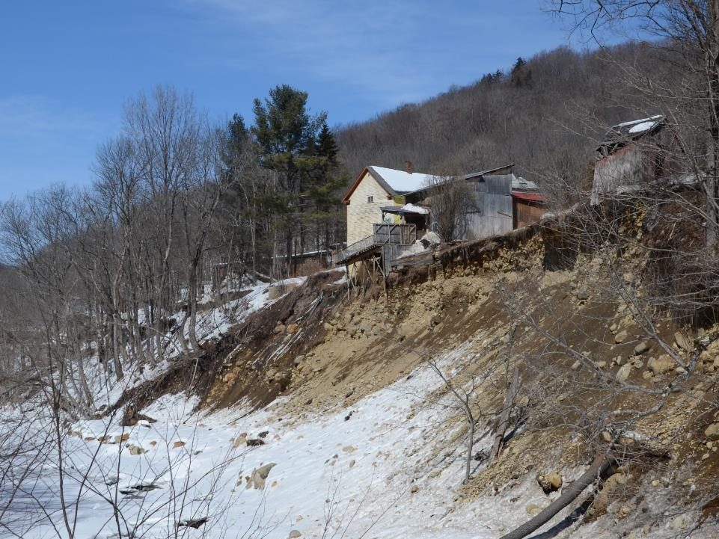

Slide 25
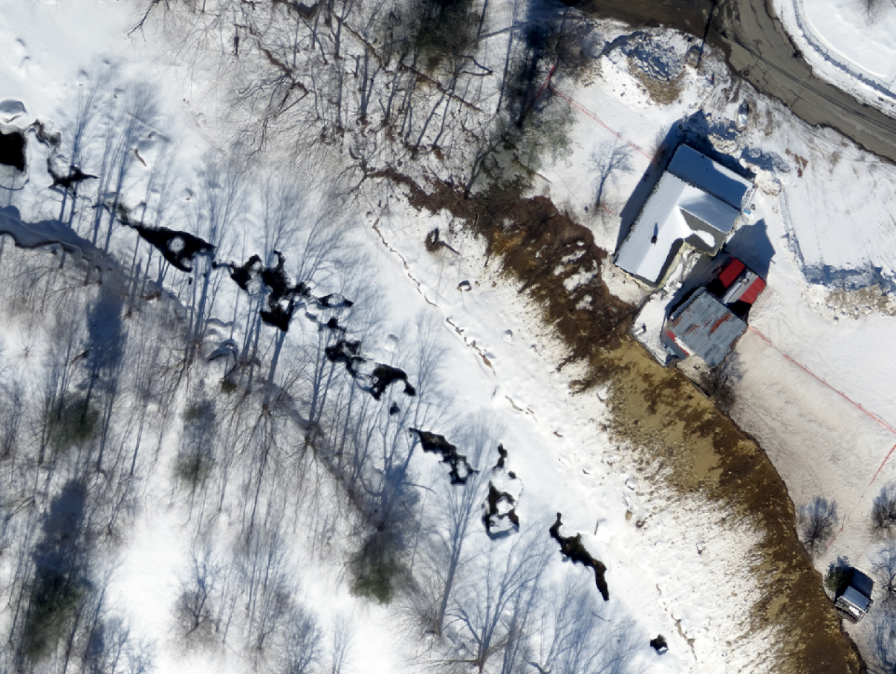

Slide 26
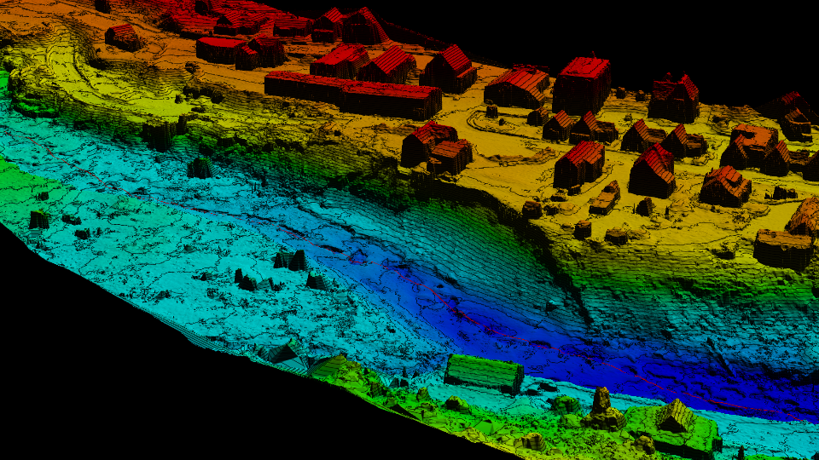

Slide 27
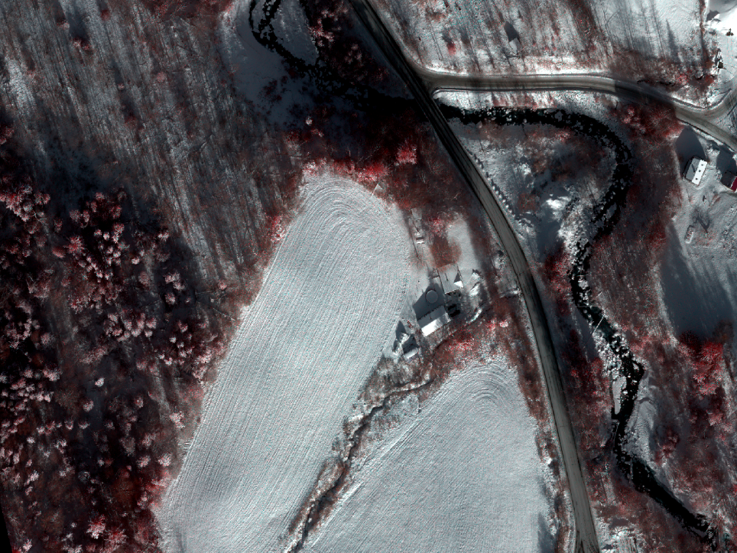

Slide 28
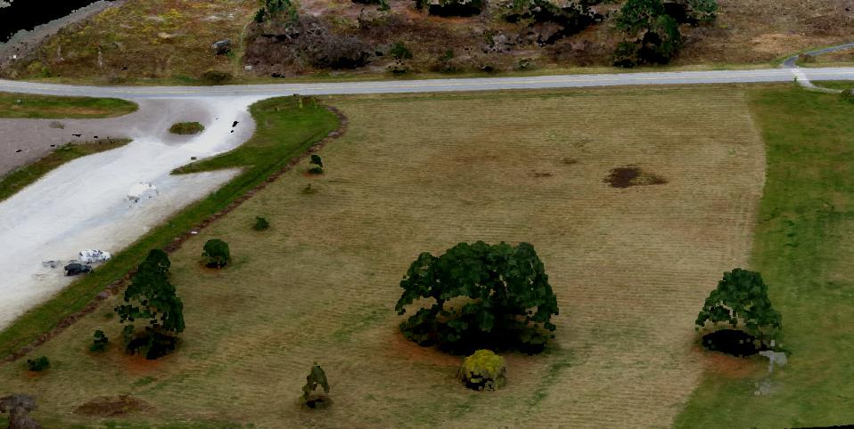

Slide 29
Jarlath O’Neil-Dunne
joneildu@uvm.edu

